Slide 1
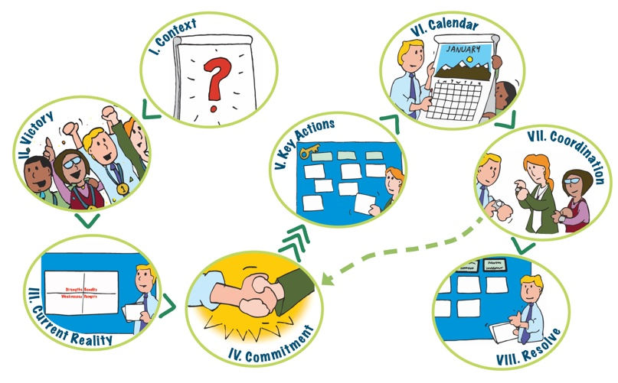
Action Planning Overview
Notes:
Action Planning employs 8 steps. For action planning to be effective, the group has to have already decided upon a project or event they want to do.
Step 1 Context - provides an overview of the process and identifies what has has been decided or is already established. It includes a brief focused conversation about the item to be planned to get people engaged, connecting with their relevant information and experience and to stimulate their thinking on the topic.
Step 2 Victory - Positions people in the future, right after the highly successful event, and asks them to look back on the event as they imagine success. We then ask objective questions that are relevant to the nature of the event or project – what did you see, hear, taste… who was there…what were the components….and add them as quickly as possible to a chart, using vibrant colors and random placement to add energy and excitement. All ideas are wanted here and broad diversity is good.
Step 3 Current Reality - Explores the Current Reality by first focusing on the team responsible for creating the event/project and identifies strengths and weaknesses of that team (R level). Then moves to identify Benefits and Dangers of Success (I level).
Step 4 Commitment - Informed by the aspirations captured in the Victory stage and current reality, the group determines what it is committed to do. This requires group consensus. The statement should be relatively high level (this is essentially defining the scope of work). If the group cannot agree here, the process ends.
Step 5 Key Actions – Uses a modified consensus workshop that organizes all the actions needed to reach the commitment by tasks that can be done by same team – resulting in identifying the teams that are needed and their scope.
Step 6 Calendar – Asks for individuals to self select into a team and, using ideas suggested during key actions, build a calendar for each team to reach their portion of the commitment.
Step 7 Coordination – Focuses the group on the calendar to identify where adjustments are needed, including any needed to achieve the commitment and explores how the group will stay coordinated
Step 8 Resolve – Reviews the plan, reaffirms the commitment, creates a celebratory spirit to deepen ownership of the plan and assures next steps are clear.

